Slide 1
Problem statement
To develop a predictive model that combines various econometric measures to foresee a financial condition (bankruptcy or not) of a firm.
PARAMETER TUNING
Improve accuracy
Tune the hyper parameters for the best model to increase the accuracy (AUC)
MODEL COMPARISON
To maximize the AUC
Compare AUC for models - Logistic Regression, Random Forest, Neural Network, Gradient Boost, XGBoost
UPSAMPLING
Address highly imbalanced data
Balance the data set by upsampling the minority class
PRE-PROCESSING
Data preparation for modelling
Analyzing data variables, transform skewed variables, feature engineering
STEP 1
STEP 2
STEP 3
STEP 4

Slide 2
Problem statement
To develop a predictive model that combines various econometric measures to foresee a financial condition (bankruptcy or not) of a firm.
PARAMETER TUNING
Improve accuracy
Tune the hyper parameters for the best model to increase the accuracy (AUC)
MODEL COMPARISON
To maximize the AUC
Compare AUC for models - Logistic Regression, Random Forest, Neural Network, XGBoost
UPSAMPLING
Address highly imbalanced data
Balance the data set by upsampling the minority class
PRE-PROCESSING
Data preparation for modelling
Analyzing data variables, transform skewed variables, feature engineering
STEP 1
STEP 2
STEP 3
STEP 4

Slide 3
FEATURE ENGINEERING
(inventory * 365 / cost of products sold)/(profit on operating activities / financial expenses)
(gross profit / total assets) – (operating expenses / total liabilities)
((gross profit + depreciation) / sales) – ((current assets - inventory) / short-term liabilities)
((gross profit + extraordinary items + financial expenses) / total assets) * ((receivables * 365) / sales)
(profit on operating activities / total assets) * ((equity - share capital) / total assets) + (profit on operating activities / financial expenses)
((gross profit / total assets) – (operating expenses / total liabilities)) / ((sales - cost of products sold) / sales)
((gross profit + extraordinary items + financial expenses) / total assets) * ((receivables * 365) / sales)
(sales (n) / sales (n-1)) + ((short-term liabilities *365) / sales)
(profit on operating activities / financial expenses) + (total costs / total sales)
(EBITDA (profit on operating activities - depreciation) / total assets) + ((short-term liabilities * 365) / cost of products sold)
Certain financial ratios that can specifically be used to provide early warning signals of possible impending bankruptcy were used to perform feature engineering.
1) Profitability ratios
2) Leverage ratios
3) Operating performance ratios
There are key ratios that can provide such warnings well in advance, giving investors plenty of time to dispose of their equity interest before the financial roof falls in.

Slide 4
Problem statement
To develop a predictive model that combines various econometric measures to foresee a financial condition (bankruptcy or not) of a firm.
PARAMETER TUNING
Improve accuracy
Tune the hyper parameters for the best model to increase the accuracy (AUC)
MODEL COMPARISON
To maximize the AUC
Compare AUC for models - Logistic Regression, Random Forest, Neural Network, XGBoost
UPSAMPLING
Address highly imbalanced data
Balance the data set by upsampling the minority class
PRE-PROCESSING
Data preparation for modelling
Analyzing data variables, transform skewed variables, feature engineering
STEP 1
STEP 2
STEP 3
STEP 4

Slide 5
HANDLING IMBALANCED DATA: UPSAMPLING
215
Since the probability of instances belonging to the majority class is significantly high in an imbalanced dataset, algorithms are much more likely to classify new observations to the majority class
We decided to resample the data in order to mitigate the effect caused by class imbalance
Since under-sampling the majority class would remove observations from the original data set, it might discard useful information
So, we use over-sampling, which increases the number of minority class members in the training set
Synthetic Minority Over-sampling Technique: SMOTE first considers the K nearest neighbors of the minority instances. It then constructs feature space vectors between these K neighbors, generating new synthetic data points on the lines
9785

Slide 6
Problem statement
To develop a predictive model that combines various econometric measures to foresee a financial condition (bankruptcy or not) of a firm.
PARAMETER TUNING
Improve accuracy
Tune the hyper parameters for the best model to increase the accuracy (AUC)
MODEL COMPARISON
To maximize the AUC
Compare AUC for models - Logistic Regression, Random Forest, Neural Network, XGBoost
UPSAMPLING
Address highly imbalanced data
Balance the data set by upsampling the minority class
PRE-PROCESSING
Data preparation for modelling
Analyzing data variables, transform skewed variables, feature engineering
STEP 1
STEP 2
STEP 3
STEP 4

Slide 7
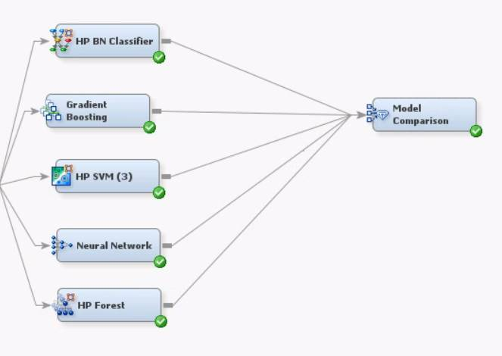
MODEL COMPARISON
We ran the following models and compared AUC results:
Naïve Bayes
Gradient Boosting
SVM
Neural Network
Random Forest
Model Node | ROC Index
HPDMForest | 0.833
HPSVM3 | 0.895
Neural | 0.791
HPBNC | 0.808
Boost | 0.756
XGBOOST | 0.927

Slide 8
Problem statement
To develop a predictive model that combines various econometric measures to foresee a financial condition (bankruptcy or not) of a firm.
PARAMETER TUNING
Improve accuracy
Tune the hyper parameters for the best model to increase the accuracy (AUC)
MODEL COMPARISON
To maximize the AUC
Compare AUC for models - Logistic Regression, Random Forest, Neural Network, XGBoost
UPSAMPLING
Address highly imbalanced data
Balance the data set by upsampling the minority class
PRE-PROCESSING
Data preparation for modelling
Analyzing data variables, transform skewed variables, feature engineering
STEP 1
STEP 2
STEP 3
STEP 4

Slide 9
PARAMETER TUNING
Model: XGBOOST | XGB Classifier
We performed grid search CV on the hypertuning parameters in an attempt to increase AUC
model = XGBClassifier(
n_estimators = 600,
max_depth = 5,
learning_rate = 0.05,
subsample = 0.8,
gamma = 0,
min_child_weight = 11,
colsample_bytree = .7,
reg_alpha = 0.0000,
scale_pos_weight = 10)

Slide 10
Thank
you!

